Slide 1
Standard form
L.O. To know what standard form is and convert from ordinary numbers.
To perform calculations involving standard form.

Slide 2
What is standard form?
Let’s take the number 9,999,999,999,999,999,999,999
Imagine having to write all those digits out every time.
What about 0.000000000000000000000000000001?
Again, there must be an easier way of writing this…
Standard form is a shorthand way of writing excessively large (or small) numbers.

Slide 3
How can we write numbers smaller?
Let’s take the number 1,400,000,000. How else could we write this?
1,400,000,000 = 1.4 billion.
Notice how we got rid of all those zeros? Let’s try 1,400,000,000,000!
1,400,000,000,000 = 1.4 trillion.
All very well… but what do we say beyond trillion? Gazillion? Maybe instead of writing the names out, we could use a mathematical notation to help us.

Slide 4
How did we get 1.4 billion?
So we know that 1,400,000,000 = 1.4 billion, but how did we get from 1,400,000,000 to 1.4?
…Remember place value?
How many times will we have to move our decimal point?
1 , 4 0 0 , 0 0 0 , 0 0 0
We can simplify that using indices to say we have divided our original number by ${10}^{9}$ to get to 1.4
We had to move it 9 times.
Using our knowledge of place value, we know this means we have divided by 10 nine times.
Standard form is written in the opposite way:
1,400,000,000 = 1.4 x ${10}^{9}$

Slide 5
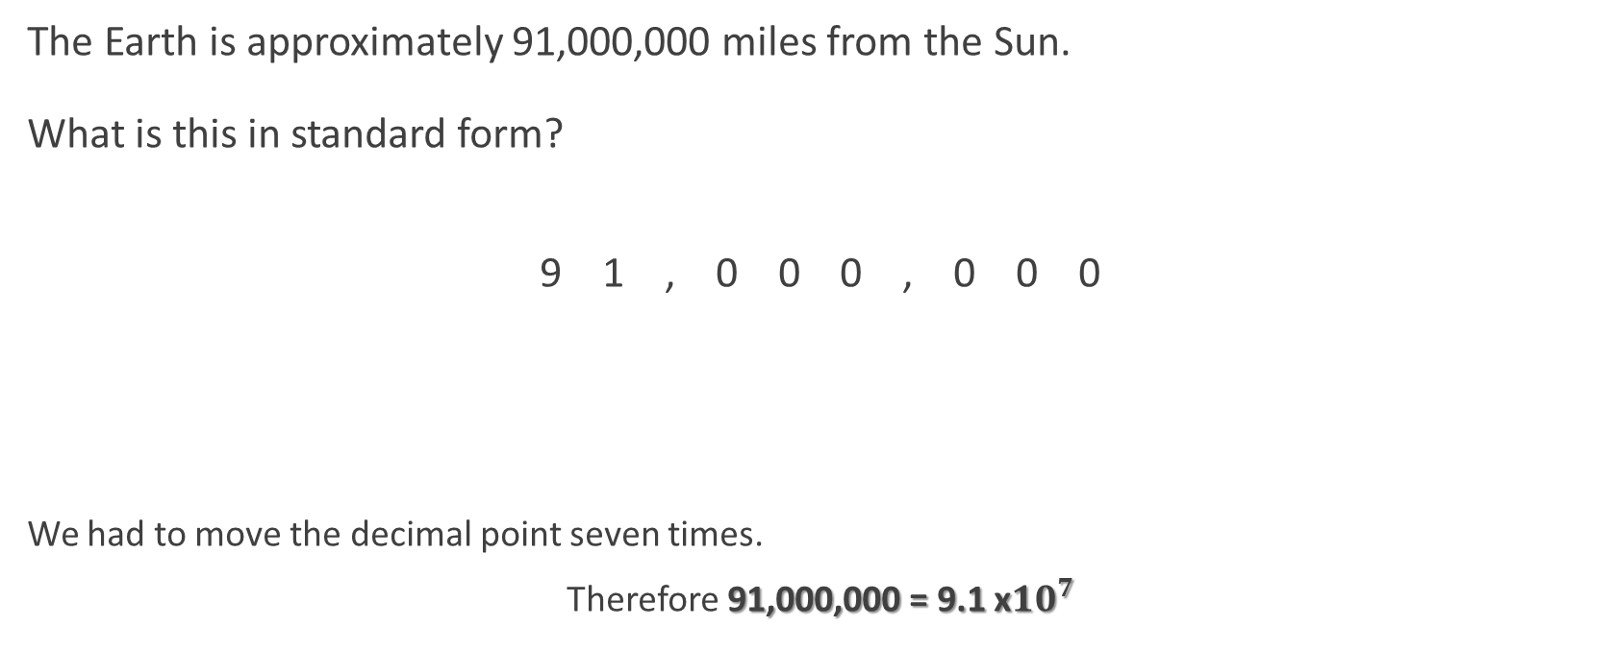
Another example
The Earth is approximately 91,000,000 miles from the Sun.
What is this in standard form?
9 1 , 0 0 0 , 0 0 0
We had to move the decimal point seven times.
Therefore 91,000,000 = 9.1 x${10}^{7}$

Slide 6
Some Golden Rules
A number in standard form is always written as x10 to the power of something.
A number in standard form will only have one whole number digit (i.e. it will only have a unit, followed by decimal points).
In converting a number into standard form, we can only get rid or zeros, unless we decide to round our number first.

Slide 7

What about working backwards?
What if you’re given 7.3 x ${10}^{5}$ and you want to convert it to an ordinary number?
Well, let’s just work backwards.
7 . 3
We want to times the number by 10 five times, therefore:
7.3 x ${10}^{5}$ = 730,000

Slide 8
It also works for small numbers!
The probability of winning the jackpot on a lottery is 0.0000000035.
What is this in standard form?
Let’s get clever here…
Dividing a number by 10 is the same as multiplying it by $\frac{1}{10}$ (try it on your calculator!)
So using that $\frac{1}{10}={10}^{−1}$
One of our index laws says that $x^{−n}= \frac{1}{x^{n}}$
Therefore dividing by 10 must be the same as multiplying by ${10}^{−1}$

Slide 9
It also works for small numbers!
The probability of winning the jackpot on a lottery is 0.0000000035.
What is this in standard form?
0 . 0 0 0 0 0 0 0 0 3 5
We’ve moved our decimal point nine places…
…But we’ve moved it in the divide direction…
…So we end up with 3.5 ÷ ${10}^{9}$.
As this is a standard form question it needs to be x10 to the something…
…And so our answer is actually 3.5 x ${10}^{−9}$

Slide 10
To recap
A very large number will have a positive power of 10 when written in standard form.
A very small number will have a negative power of 10 when written in standard form.

Slide 11
Your go!
Write 82,600,000 in standard form.
Write 3.45 x ${10}^{5}$ as an ordinary number.
Write 0.00000002 in standard form.
Write 7.9 x ${10}^{−4}$ as an ordinary number.
8.26 x ${10}^{7}$
345,000
2 x ${10}^{−8}$
0.00079

Slide 12
Calculating with standard form: Multiplying
Sometimes we may be asked to calculate using standard form.
How would we multiply two standard form numbers together?
Let’s say we have to multiply 2 x${10}^{6}$ by 3 x${10}^{3}$.
Start off by writing out the sum.
2 x ${10}^{6}$ x 3 x ${10}^{3}$
Now separate the numbers from the power of ten.
2 x 3 x ${10}^{6}$ x ${10}^{3}$

Slide 13
Calculating with standard form: Multiplying
Now separate the numbers from the power of ten.
2 x 3 x ${10}^{6}$ x ${10}^{3}$
Notice how we can easily do 2 x 3?
6 x ${10}^{6}$ x ${10}^{3}$
Well we can easily do ${10}^{6}$ x ${10}^{3}$ too, using our rule of indices.
$$x^{m}+x^{n}=x^{m+n}$$
Therefore, our final answer will be:
6 x ${10}^{9}$
Which is already in standard form.

Slide 14
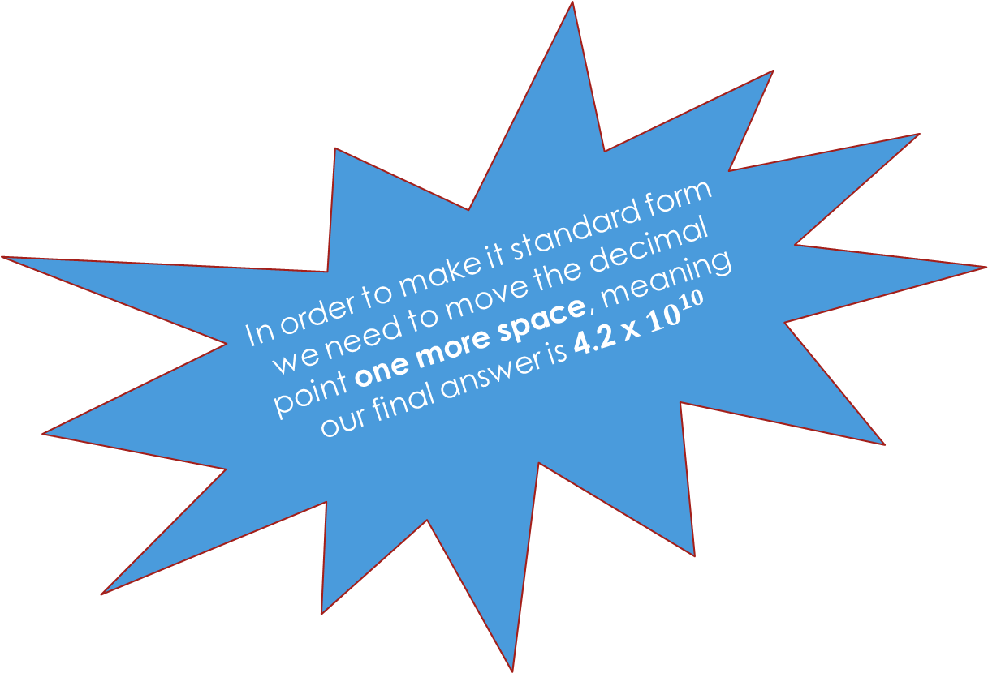
CALCULATING WITH STANDARD FORM: MULTIPLYING
A number in standard form will only have one whole number digit (i.e. it will only have a unit, followed by decimal points).
How about this question:
6 x${10}^{4}$ x 7 x${10}^{5}$
Let’s work through it.
6 x ${10}^{4}$ x 7 x ${10}^{5}$
6 x 7 x ${10}^{4}$ x ${10}^{5}$
42 x ${10}^{4}$ x ${10}^{5}$
42 x ${10}^{9}$
Seems right… but let’s remind ourselves of one of the rules of standard form.
In order to make it standard form we need to move the decimal point one more space, meaning our final answer is 4.2 x ${10}^{10}$

Slide 15
Calculating with standard form: Dividing
Dividing standard form numbers works in a very similar way.
Consider the sum: $\frac{6 ×{ 10}^{7}}{2 × {10}^{3}}$
Again, we deal with the numbers separately to the powers of ten.
6 $÷$ 2 = 3
${ 10}^{7}$ ÷ ${ 10}^{3}$ = ${ 10}^{4}$ (using rules of indices)
Therefore the answer is 3 x ${ 10}^{4}$

Slide 16
Calculations with standard form: Adding & Subtracting
To add/subtract standard form numbers, the easiest method is usually to write them as ordinary numbers, do the sum, and then convert them back into standard form.
e.g. (3.2 x ${10}^{3}$) + (2.1 x ${10}^{4}$)
3.2 x ${10}^{3}$ = 3,200
2.1 x ${10}^{4}$ = 21,000
3,200 + 21,000 = 24,200
= 2.42 x ${10}^{4}$

